Slide 1

“To-Do List”
Task - 4

Slide 2

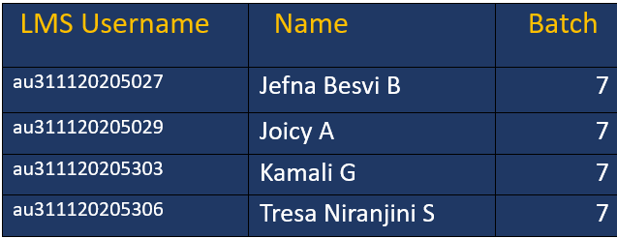
To-Do List
▪
A to-do list serves as the cornerstone for organized execution. It acts as a dynamic roadmap, guiding the team through tasks, deadlines, and priorities.
LMS Username
Name
Batch
au311120205012
Anto Vishvack M
16
au311120205018
Calvin Jacob Fernando
16
au311120205028
Jenish Richard
16
au311120205030
Joseph Aron Babu Pappachan
16

Slide 3
Task-4
Create UI and implement various components using react
Split design into components and Higher order Components
Define structure of the components
Set the basic ui components with dummy data
Integrate the APIs to frontend to ensure the dynamic feature of website
Point base api to the severs base url
Design api calls for each element
Handle errors in the output
Render output of apis to different low level components
Secure content of post apisx
Evaluation Metric
100% Completion of the above tasks
Learning Outcome
Developing complicated UI using react components
Using props drilling and context to pass variables
Getting familiar with different type of api calls
Handling different input data

Slide 4

Step-Wise Description
Pick a Back end Technology(nodejs).
Implement CRUD operations in your backend codes for task.
Adjust front end code to communicate with the backend for API tasks.
Deploy your application,hosting the backend on the services like Heroku or aws.
Summary of Task4
Create a backend project and install necessary dependencies.
Setup and connect a database(MongoDB,PostgreSQL).
Test the full-stack application to ensure the proper data handling.

Slide 5

Assessment Parameter
Setup project for the “To-Do-list project
Setup basic structure of text-Editor project
Create a main component with the Outer structure of To-Do-List
Check-List
Create main component with
All features
Create a button component With on click handler
Create a json object to store
Data for text editor
Create a evaluate Expresion
Function to evaluate value
Push your changes to github

Slide 6

Submission Github
https://github.com/tresaniranjini/NM-LICET-IT-GROUP7

Slide 7


